Slide 1
Identifying HARPed Loans
January 2016

Slide 2
INTRODUCTION
1
Importance of identifying HARP loans
Loans that have been refinanced through the Home Affordable Refinance Program (HARP) generally prepay slower than other refinance loans that have undergone full underwriting.
2
Existing algorithms for identifying HARPed Loans
Prior to August 2013:
This is the period prior to Freddie Mac providing loan-level credit information for fully underwritten mortgages
MI matches were used to identify potential HARPed loans with OLTV > 80 and loan purpose as Refi-NCO
This algorithm cannot effectively identify HARPed loans with OLTV of 80% or lower
After August 2013
With the new Freddie Mac and Fannie Mae loan-level credit information, an algorithm was developed to identify 30-year fixed –rate HARP loans by mapping the credit dataset to the standard database
There are no restrictions on the LTV ratio
The credit data set has about a one year lag, which means that recently originated loans cannot be identified as being HARPed or not using the current algorithm

Slide 3
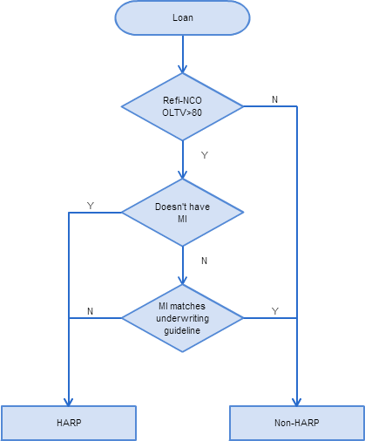
EXISTING ALGORITHM I MI Matching Method
Three Step Mapping
Step 1: The loan should be refi-NCO loan, with Origination LTV >80.
Otherwise, it’s Non-HARPed.
Step 2: If the loan doesn’t have MI, we match it as HARPed loan;
If not, go to step 3.
Step 3: For the loans that potentially carry over MI check whether MI matches current underwriting guidelines. If there’s no match, then it’s a HARP loan.
Cons
Cannot match loans with OLTV equal or lower than 80.
Highly sensitive to the correctness of MI underwriting guidelines.
Not clear how the check for matching current underwriting guidelines works
Change HARP to HARPed, Non-HARP to Non-HARPed

Slide 4
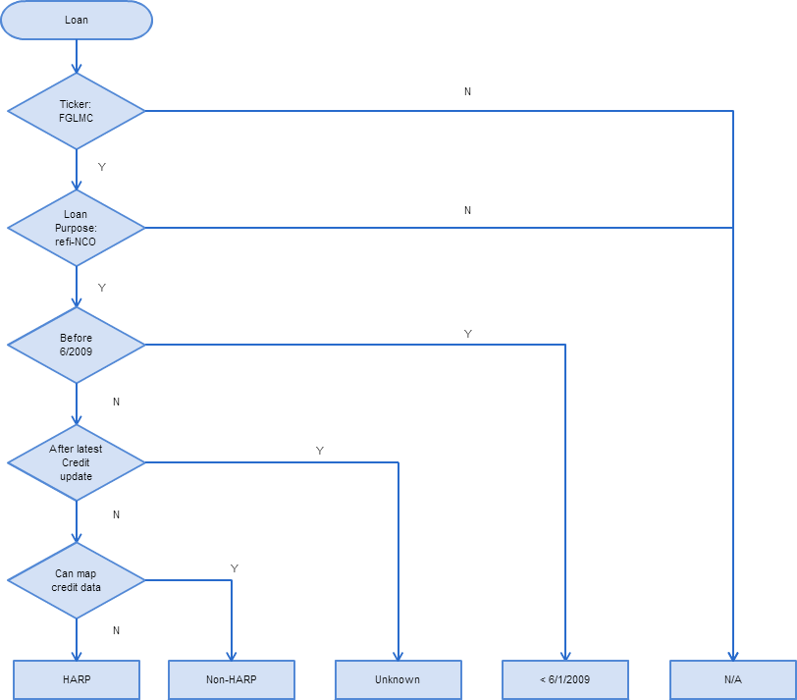
EXISTING ALGORITHM II Credit Dataset Mapping Method
Credit Data Mapping
No restrictions on OLTV > 80.
More accurate as there is no dependency on MI underwriting criteria.
Cons
The credit data set has about a one year lag, meaning we don’t have the most recent origination data. Consequently, we have to mark the HARP status as unknown for recently (with the last year) originated loans.
Change HARP to HARPed, Non-HARP to Non-HARPed

Slide 5
Existing Algorithm II Credit Dataset Mapping Method
Pre-HARP
HARP
Non-HARP
N/A: Purchas, refi-CO
All the blue area can be consider as non-HARP loans; brown area is HARP loans percentage.
Red area is the loans originated within the most recent year. The credit dataset has a gap on this area.
Need to improve the mapping for the red area.

Slide 6
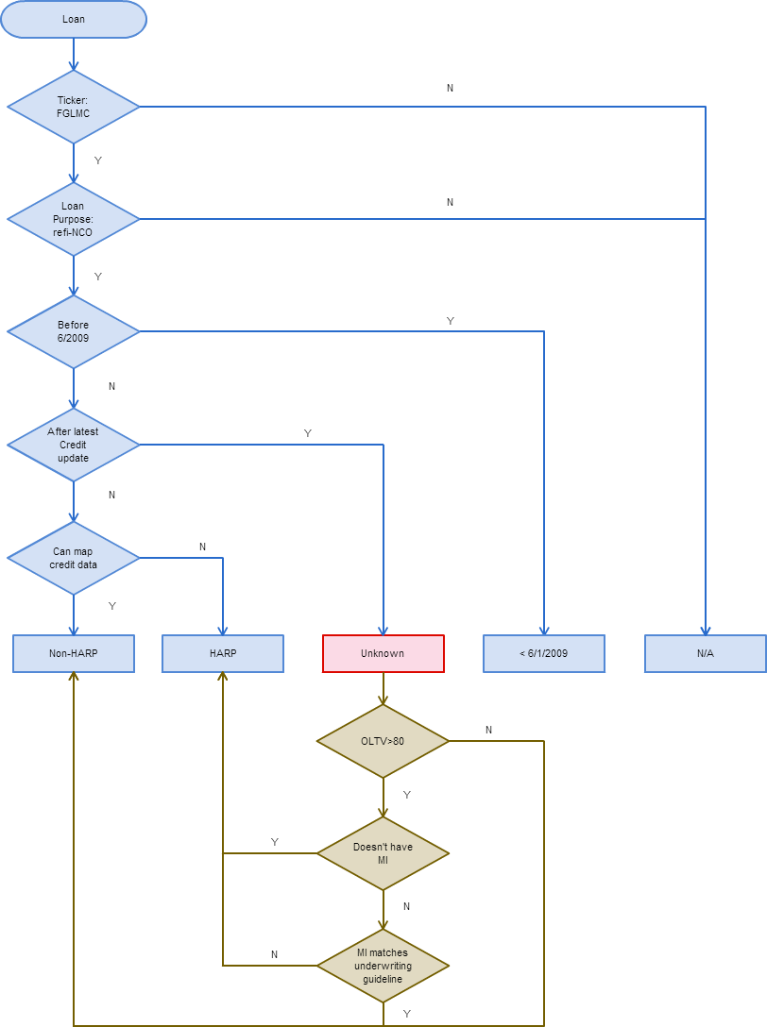
ENHANCED ALGORITHM
Asof
Algorithm I
2009.01
...
2014.01
2016.01
120
Mapped Data | Un-mapped Data
Mapped Data | Un-mapped Data
OLTV
One-year gap, unable to map recent year HARP loans.
80
...
30
Asof
Algorithm II
2009.01
...
2014.01
2016.01
120
Mapped Data | Mapped Data
Un-mapped Data | Un-mapped Data
OLTV
80
...
Unable to map HARP loans with LTV <= 80.
30
Asof
Enhanced Algo.
2009.01
...
2014.01
2016.01
120
Mapped Data | Mapped Data
Mapped Data | Un-mapped Data
Integrate algo II into algo I for the unknown one year gap.
OLTV
80
...
30

